Slide 1
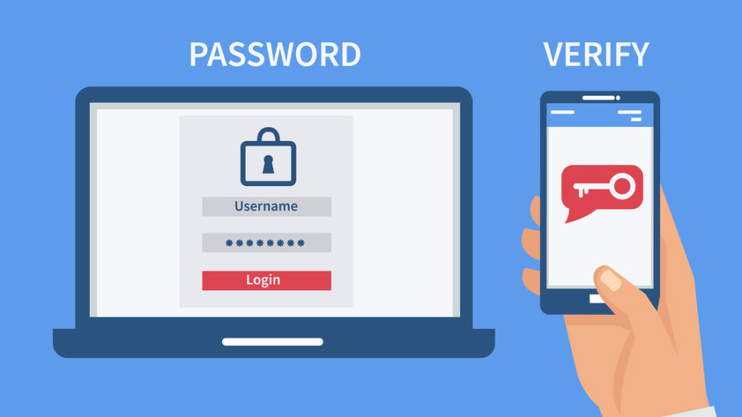
2-Factor Authentication

Slide 2

The 3 Areas of 2-Factor Authentication
Something you know
Personal Identification Number
Secret Questions
Something you have
Smartphone
Credit Card
Something you are
Fingerprint
Face Scan

Slide 3
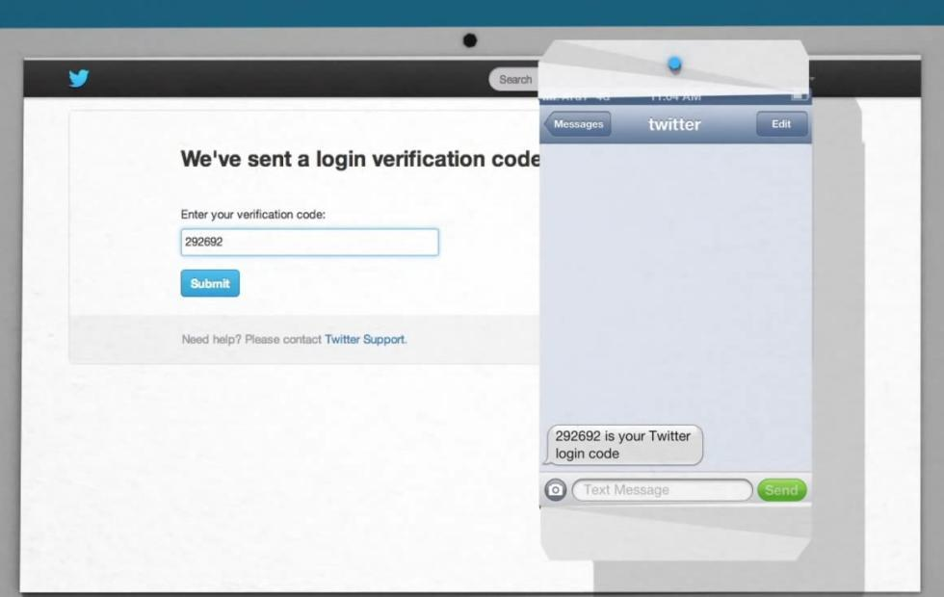
Text-Message and Voice-based 2-Factor Authentication
Connects directly to your phone
One time passcode
Least secure form of authentication

Slide 4
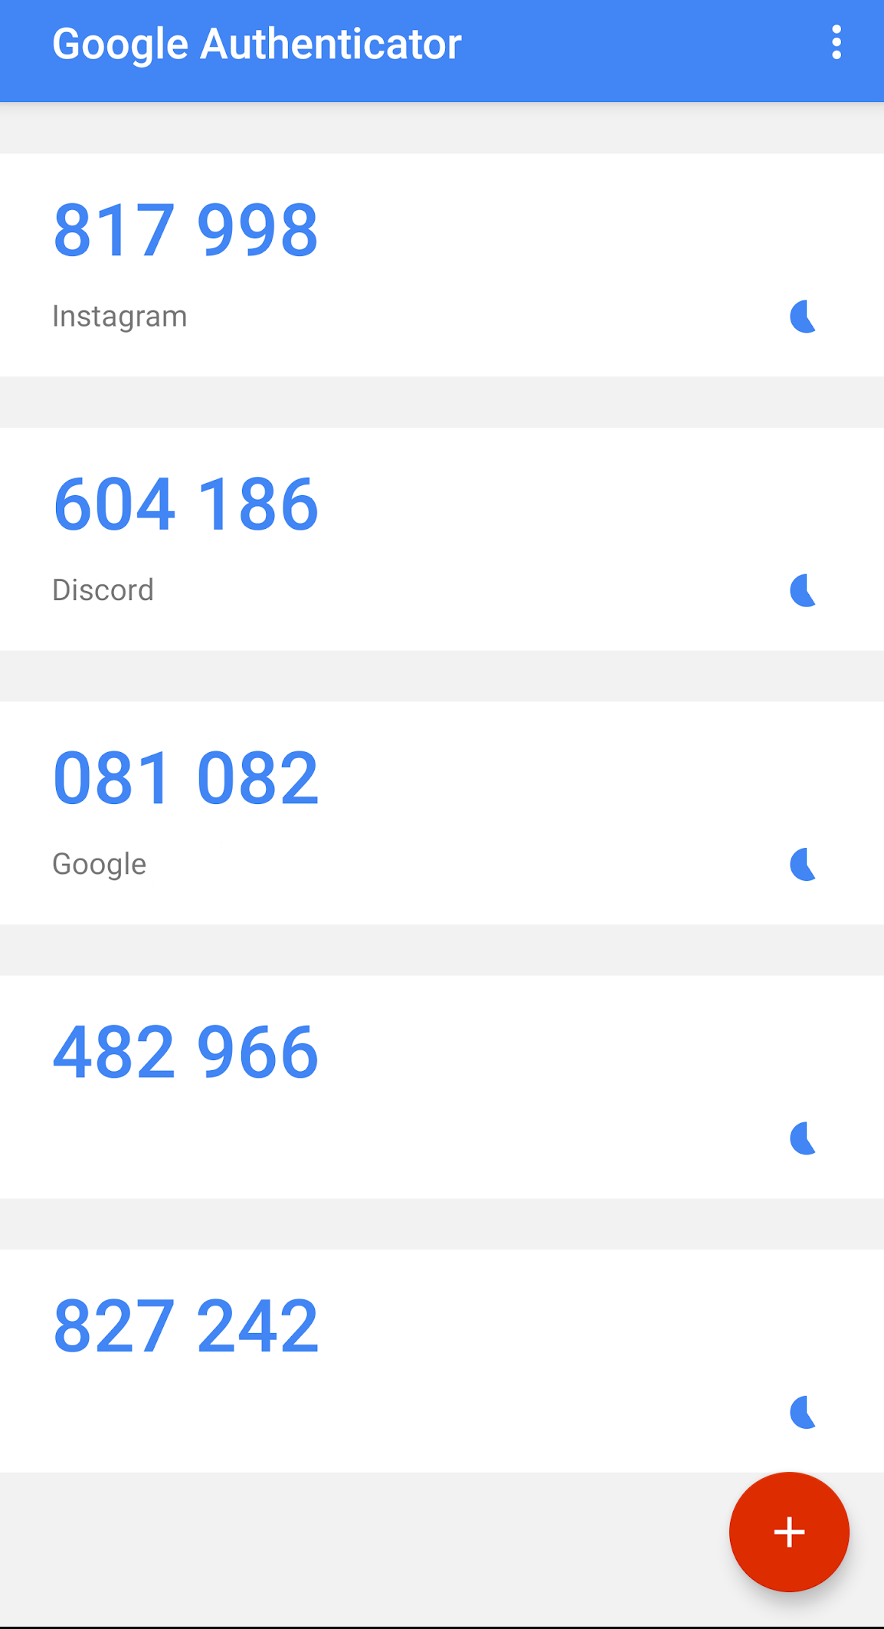
Software Tokens for 2-Factor Authentication
Very popular form of 2-Factor Authentication
An app that generates a new code every minute
No chance of hacker interception

Slide 5
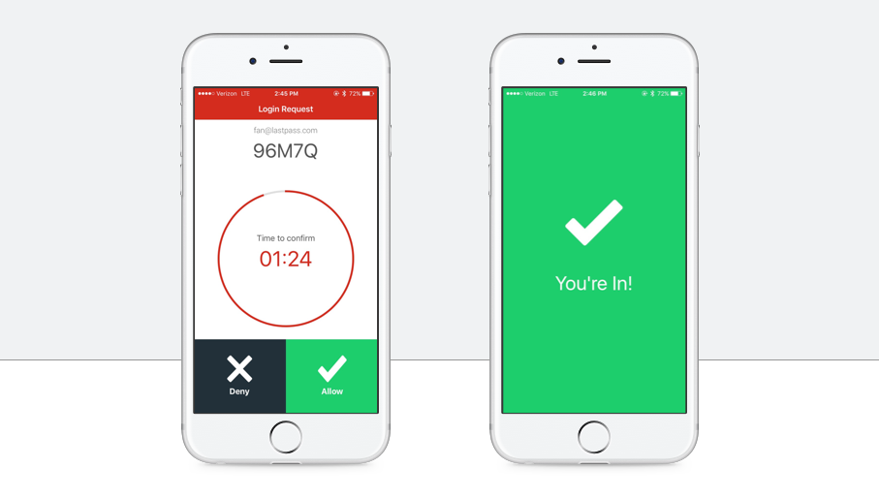
Push Notification for 2-Factor Authentication
Connects the website to an app
Fast and easy

Slide 6
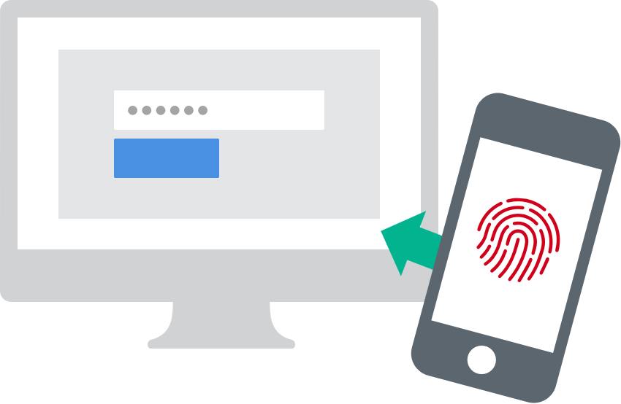
Biometric 2-Factor Authentication
Not very popular
Used mainly in professional environments

Slide 7
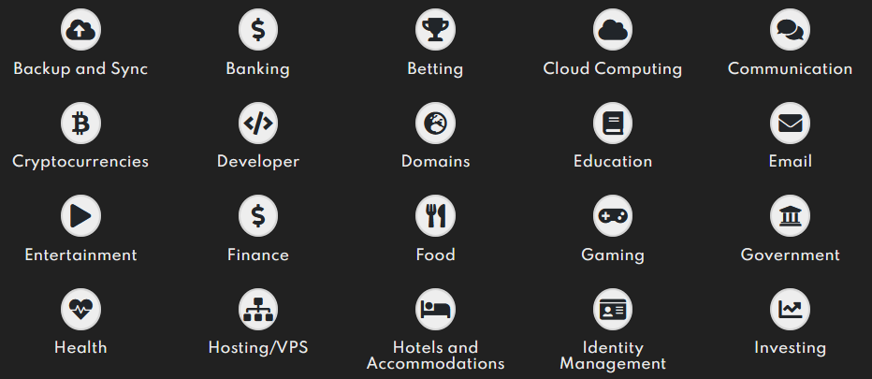
Wrapping Up
Weak passwords remain a leading cause of security breaches
Ask yourself what you are giving to the website
Check what sites support 2-factor authentication at https://2fa.directory/

